Slide 1
Opening of final day of CM on ML for ND
Georg Schnabel
Nuclear Data Section
Division of Physical and Chemical Sciences NAPC
Department for Nuclear Sciences and Applications
IAEA, Vienna
CM on ML for ND
11 December 2020

Slide 2
Outline
Recap of what we have heard
Technical discussion block
General discussion block

Slide 3
Method aspects

Slide 4
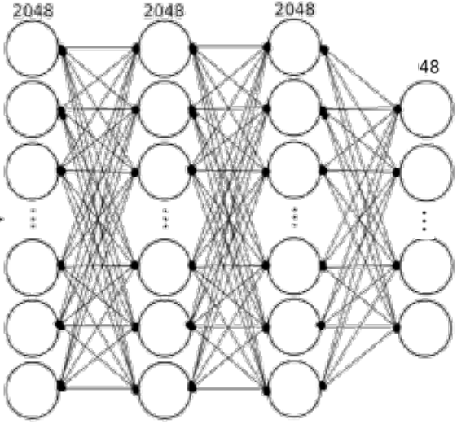
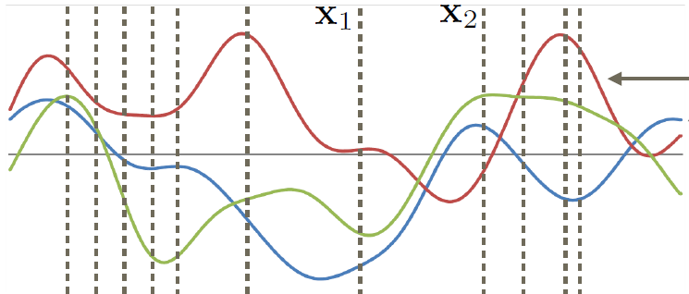
Approaches
In Bayesian framework: GPs, BMA, mixture models, Bayesian NN
Others: LinearSVM, AdaBoost, Nearest Neighbors, …
Ensemble methods in general

Slide 5
Uncertainties and ML methods
Bayesian methods allow incorporation of uncertainties and correlations as a design feature
Other very powerful methods not, such as Random Forrest and Neural Networks
One way or another (e.g., cross validation error or embedding a method in the Bayesian framework), uncertainty can be accounted for
Interesting approach: using a neural network to predict distribution parameters of a probability distribution

Slide 6
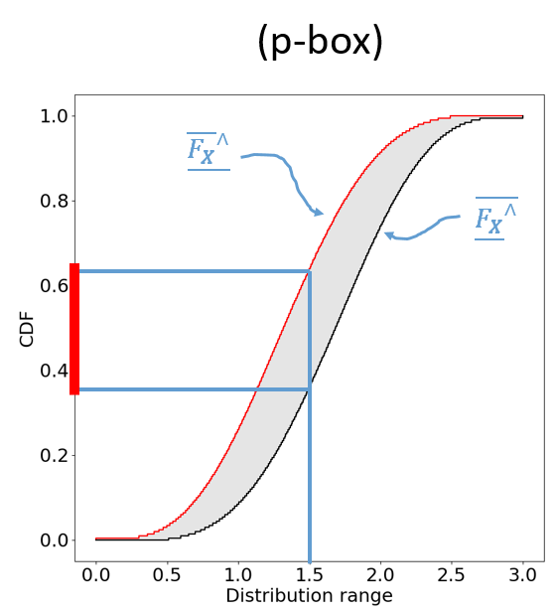
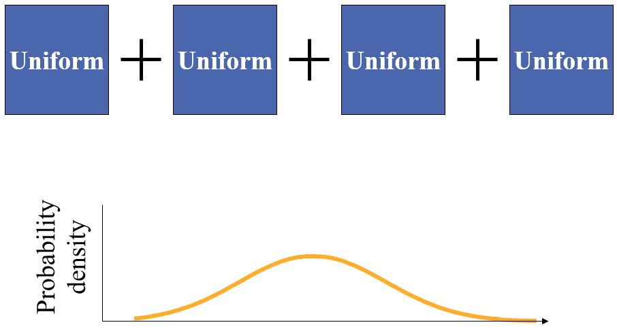
Alternative concepts of uncertainty
Bayesian framework not the only way to do inference in the face of uncertainty
Besides Mixture Density Networks, e.g., using probability boxes

Slide 7
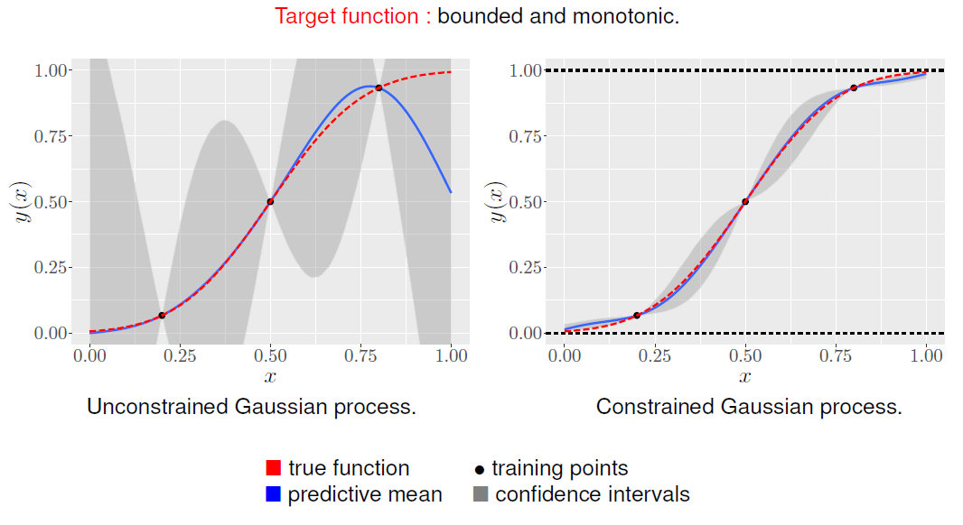
Inclusion of more realistic assumptions
More realistic constraints can be embedded in Bayesian methods going beyond GLS (e.g., inequality constraints)
In other methods enforcing constraints may be achieved by re-parameterization of feature values and outputs
Inequality constraints in GPs

Slide 8
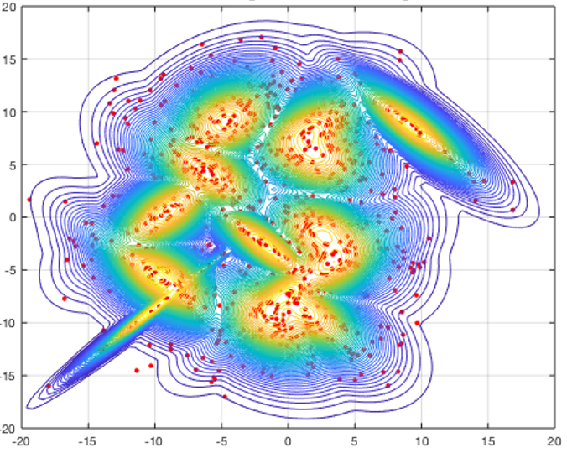
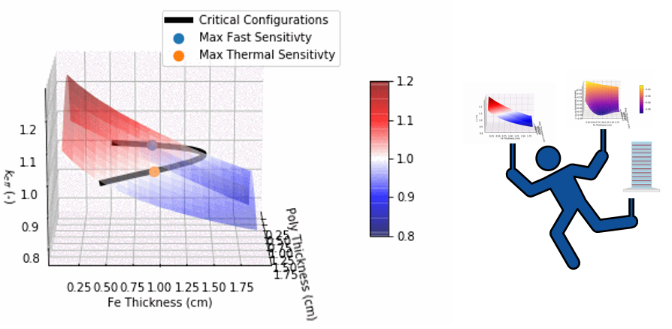
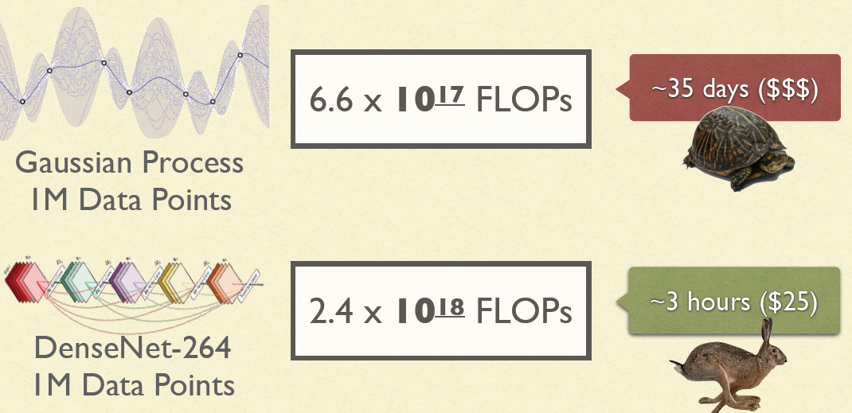
Scalability of approaches
Some methods do not scale well to large data sets or cannot be applied with expensive computer models. But boundaries are pushed back more and more.
Bayesian global optimization
Transitional MCMC
GPyTorch

Slide 9
Applications of ML

Slide 10
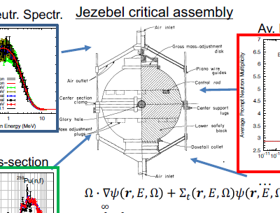
Random forests
Validation of nuclear data
Detection of biases in evaluations
Global estimation of model parameters
Classification of spin assignments in RR

Slide 11
Gaussian processes
Nuclear data evaluation (as model for fitting, model defects, priors on model parameters)
Optimization of benchmark experiments
Data-driven outlier detection (one-class SVM with RBF kernel) / uncertainty correction (as model for feasible cross section curves)
Other Bayesian methods:
Bayesian model averaging as nuclear data evaluation

Slide 12
Neural networks
Prediction of Fission yield probabilities
Radiation metrology: neutron spectrum unfolding and activation prediction (e.g., Cs137)
Anomaly detection in nuclear reactors
Envisaged, as replacement for GP surrogate in design optimization of integral benchmarks
Prediction of fission yields

Slide 13
Technical discussion block

Slide 15
General discussion block

Slide 16
Topic #1: Acceptance of ML
Between hype, fear and real benefit: How do we get nuclear physics experts to work alongside and leverage their knowledge? Level of communication, technical infrastructures, initiatives, etc.

Slide 17
Topic #2: Collaboration / Transparency / Accesibility
Which initiatives as a community can we start to get closer to a culture of sharing (e.g. publish early and accessible by everyone, sharing of codes and data)
Would it help if we formulate a common project under the umbrella of the IAEA?

Slide 18
Topic #3: Improvements & Future
Any topic you missed you would think should be represented in a AI/ML meeting/workshop on ND?
Do you think follow-up CMs dedicated to ML for ND would be interesting/useful?
Should we consider different formats as well? (hands-on workshops, summer schools, etc.)
What initiatives exist (national and international) dealing with AI/ML in nuclear data at present? (e.g., CORTEX)

